Slide 1



Insurance Complaints Portfolio
View in Power BI
Last data refresh:
12/24/2021 5:46:52 PM UTC
Downloaded at:
12/24/2021 5:49:53 PM UTC

Slide 2
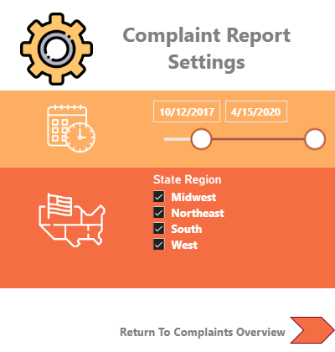
Settings
Notes:
Complaint Report Settings
No alt text provided
basicShape
No alt text provided
basicShape
No alt text provided
Return To Complaints Overview
No alt text provided
shape
No alt text provided
slicer
No alt text provided
image
No alt text provided
image
No alt text provided
image
No alt text provided
slicer
No alt text provided

Slide 3
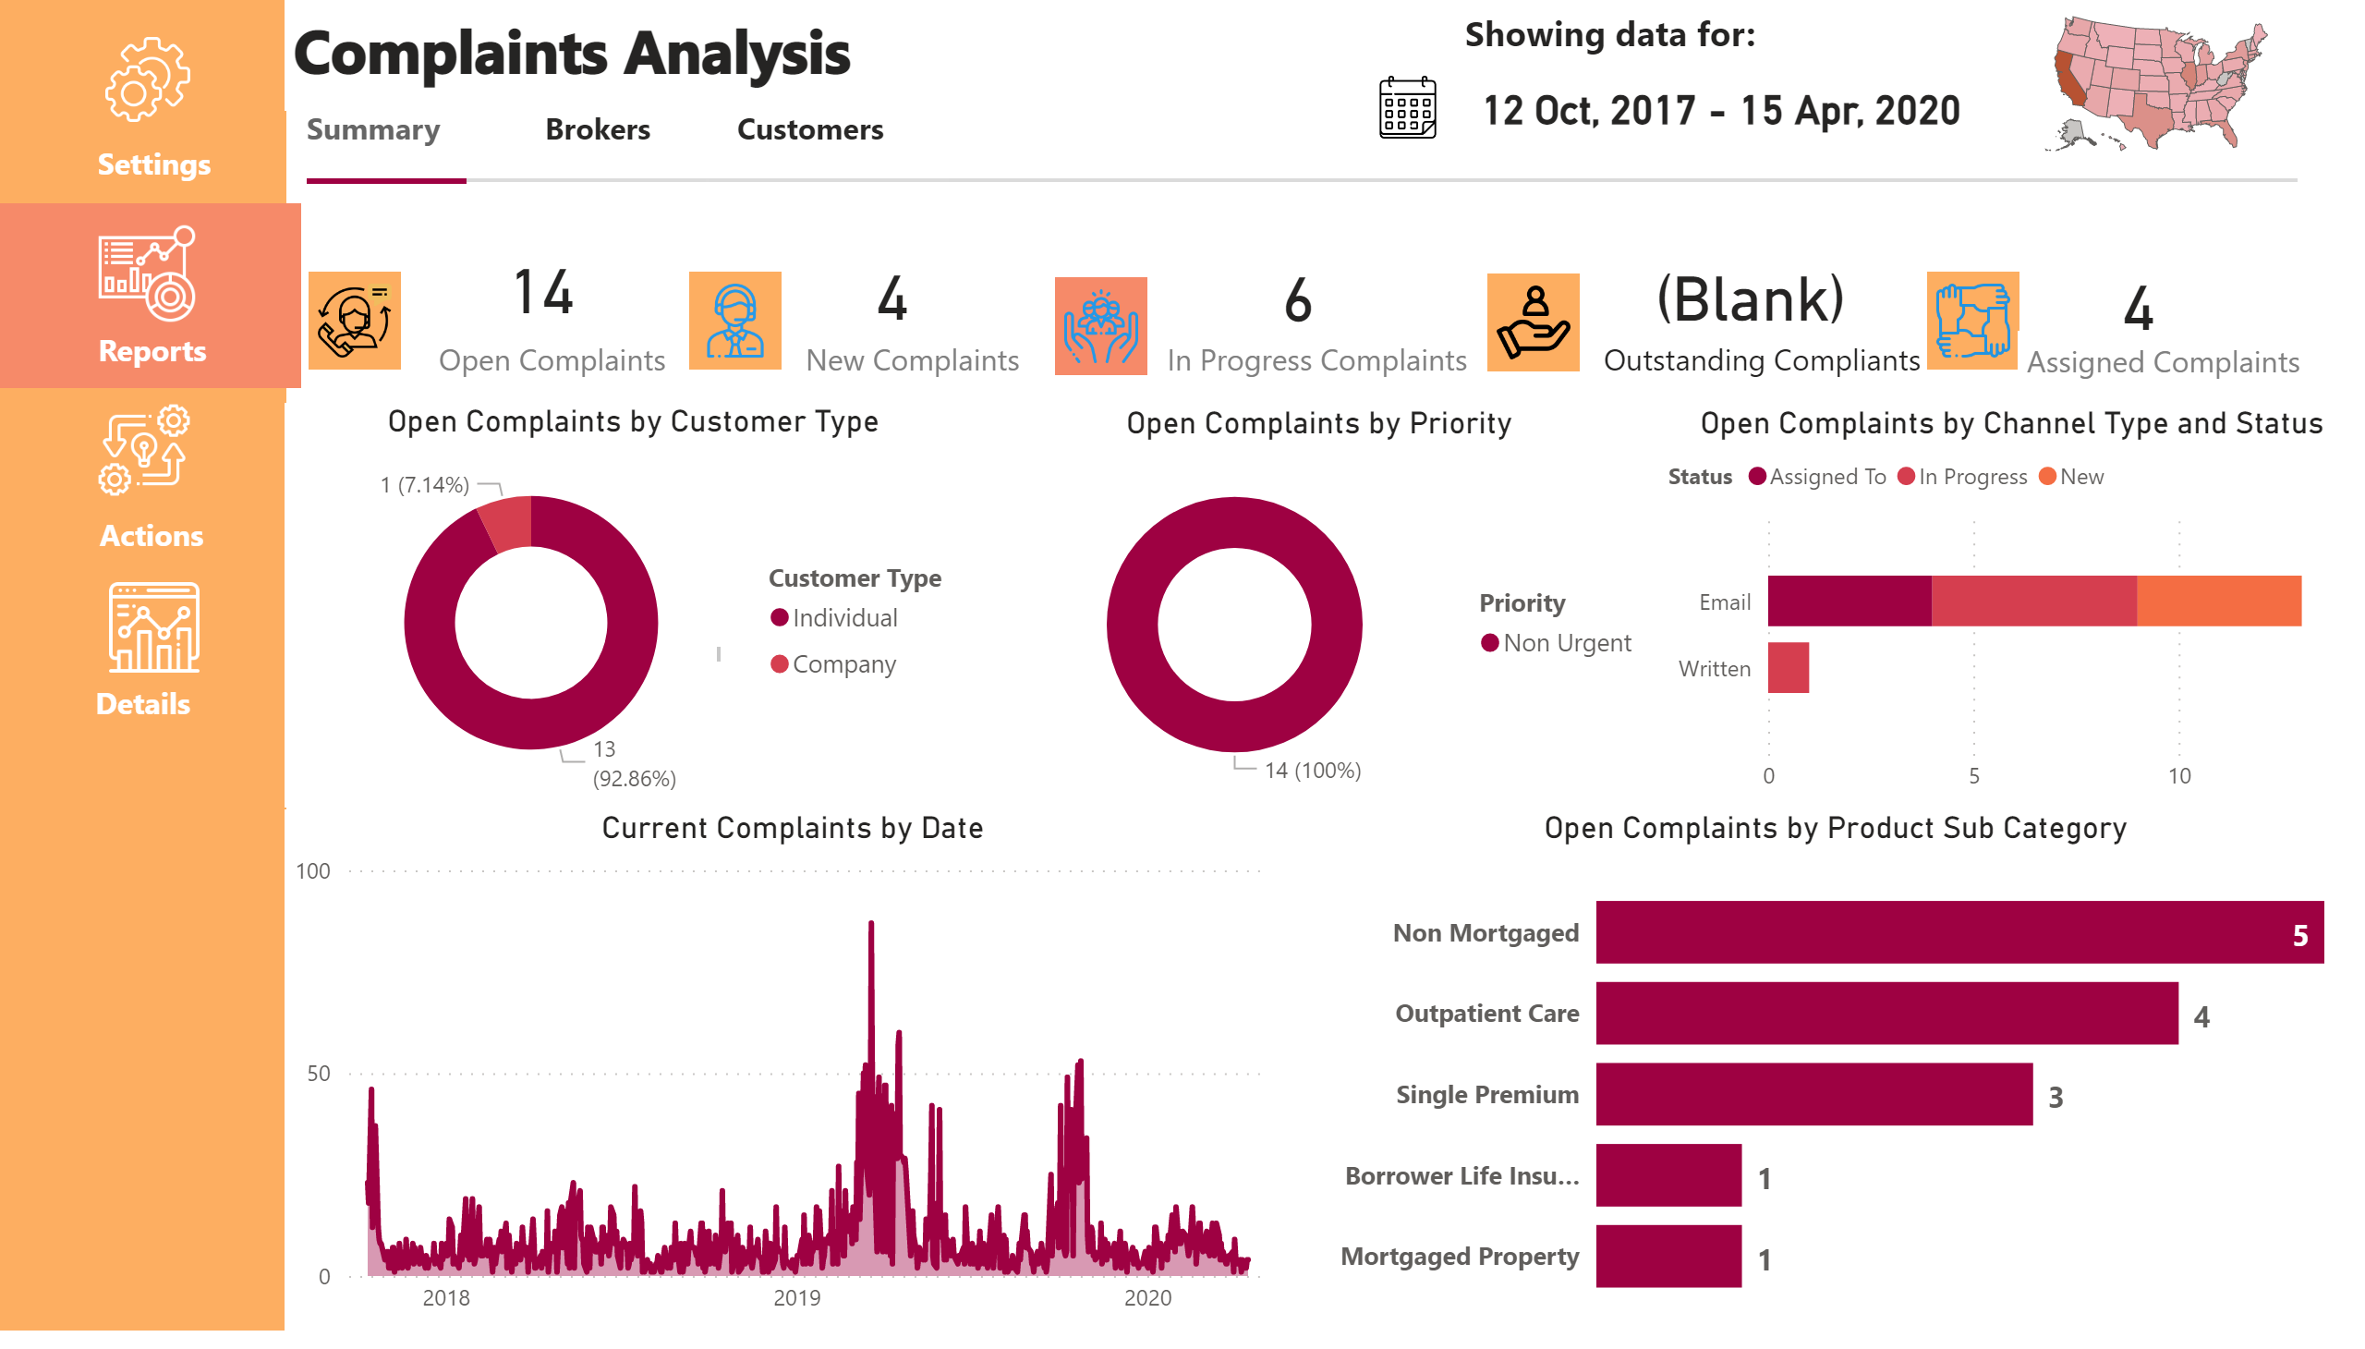
Complaints
Notes:
basicShape
No alt text provided
image
No alt text provided
image
No alt text provided
image
No alt text provided
image
No alt text provided
textbox
No alt text provided
textbox
No alt text provided
card
No alt text provided
textbox
No alt text provided
image
No alt text provided
basicShape
No alt text provided
textbox
No alt text provided
textbox
No alt text provided
textbox
No alt text provided
image
No alt text provided
textbox
No alt text provided
textbox
No alt text provided
Reports
No alt text provided
Actions
No alt text provided
Details
No alt text provided
shape
No alt text provided
textbox
No alt text provided
barChart
No alt text provided
card
No alt text provided
donutChart
No alt text provided
card
No alt text provided
donutChart
No alt text provided
card
No alt text provided
areaChart
No alt text provided
card
No alt text provided
clusteredBarChart
No alt text provided
shapeMap
No alt text provided
slicer
No alt text provided
basicShape
No alt text provided
textbox
No alt text provided
image
No alt text provided
textbox
No alt text provided
image
No alt text provided
textbox
No alt text provided
shape
No alt text provided
shape
No alt text provided
image
No alt text provided
image
No alt text provided
card
No alt text provided

Slide 4
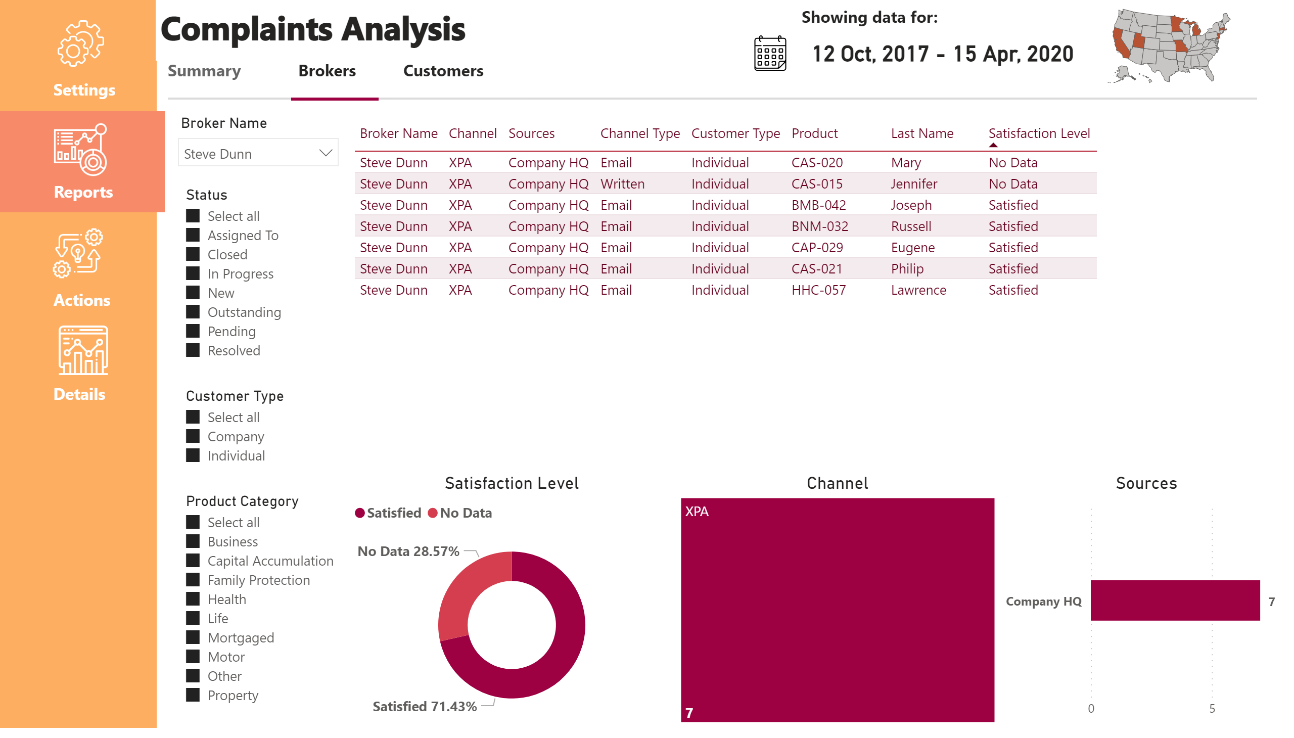
Brokers
Notes:
basicShape
No alt text provided
image
No alt text provided
image
No alt text provided
image
No alt text provided
image
No alt text provided
textbox
No alt text provided
textbox
No alt text provided
Reports
No alt text provided
Actions
No alt text provided
Details
No alt text provided
shape
No alt text provided
textbox
No alt text provided
shapeMap
No alt text provided
card
No alt text provided
image
No alt text provided
basicShape
No alt text provided
textbox
No alt text provided
textbox
No alt text provided
textbox
No alt text provided
textbox
No alt text provided
shape
No alt text provided
shape
No alt text provided
slicer
No alt text provided
slicer
No alt text provided
slicer
No alt text provided
slicer
No alt text provided
tableEx
No alt text provided
Satisfaction Level
No alt text provided
Channel
No alt text provided
Sources
No alt text provided
shape
No alt text provided
slicer
No alt text provided
basicShape
No alt text provided

Slide 5
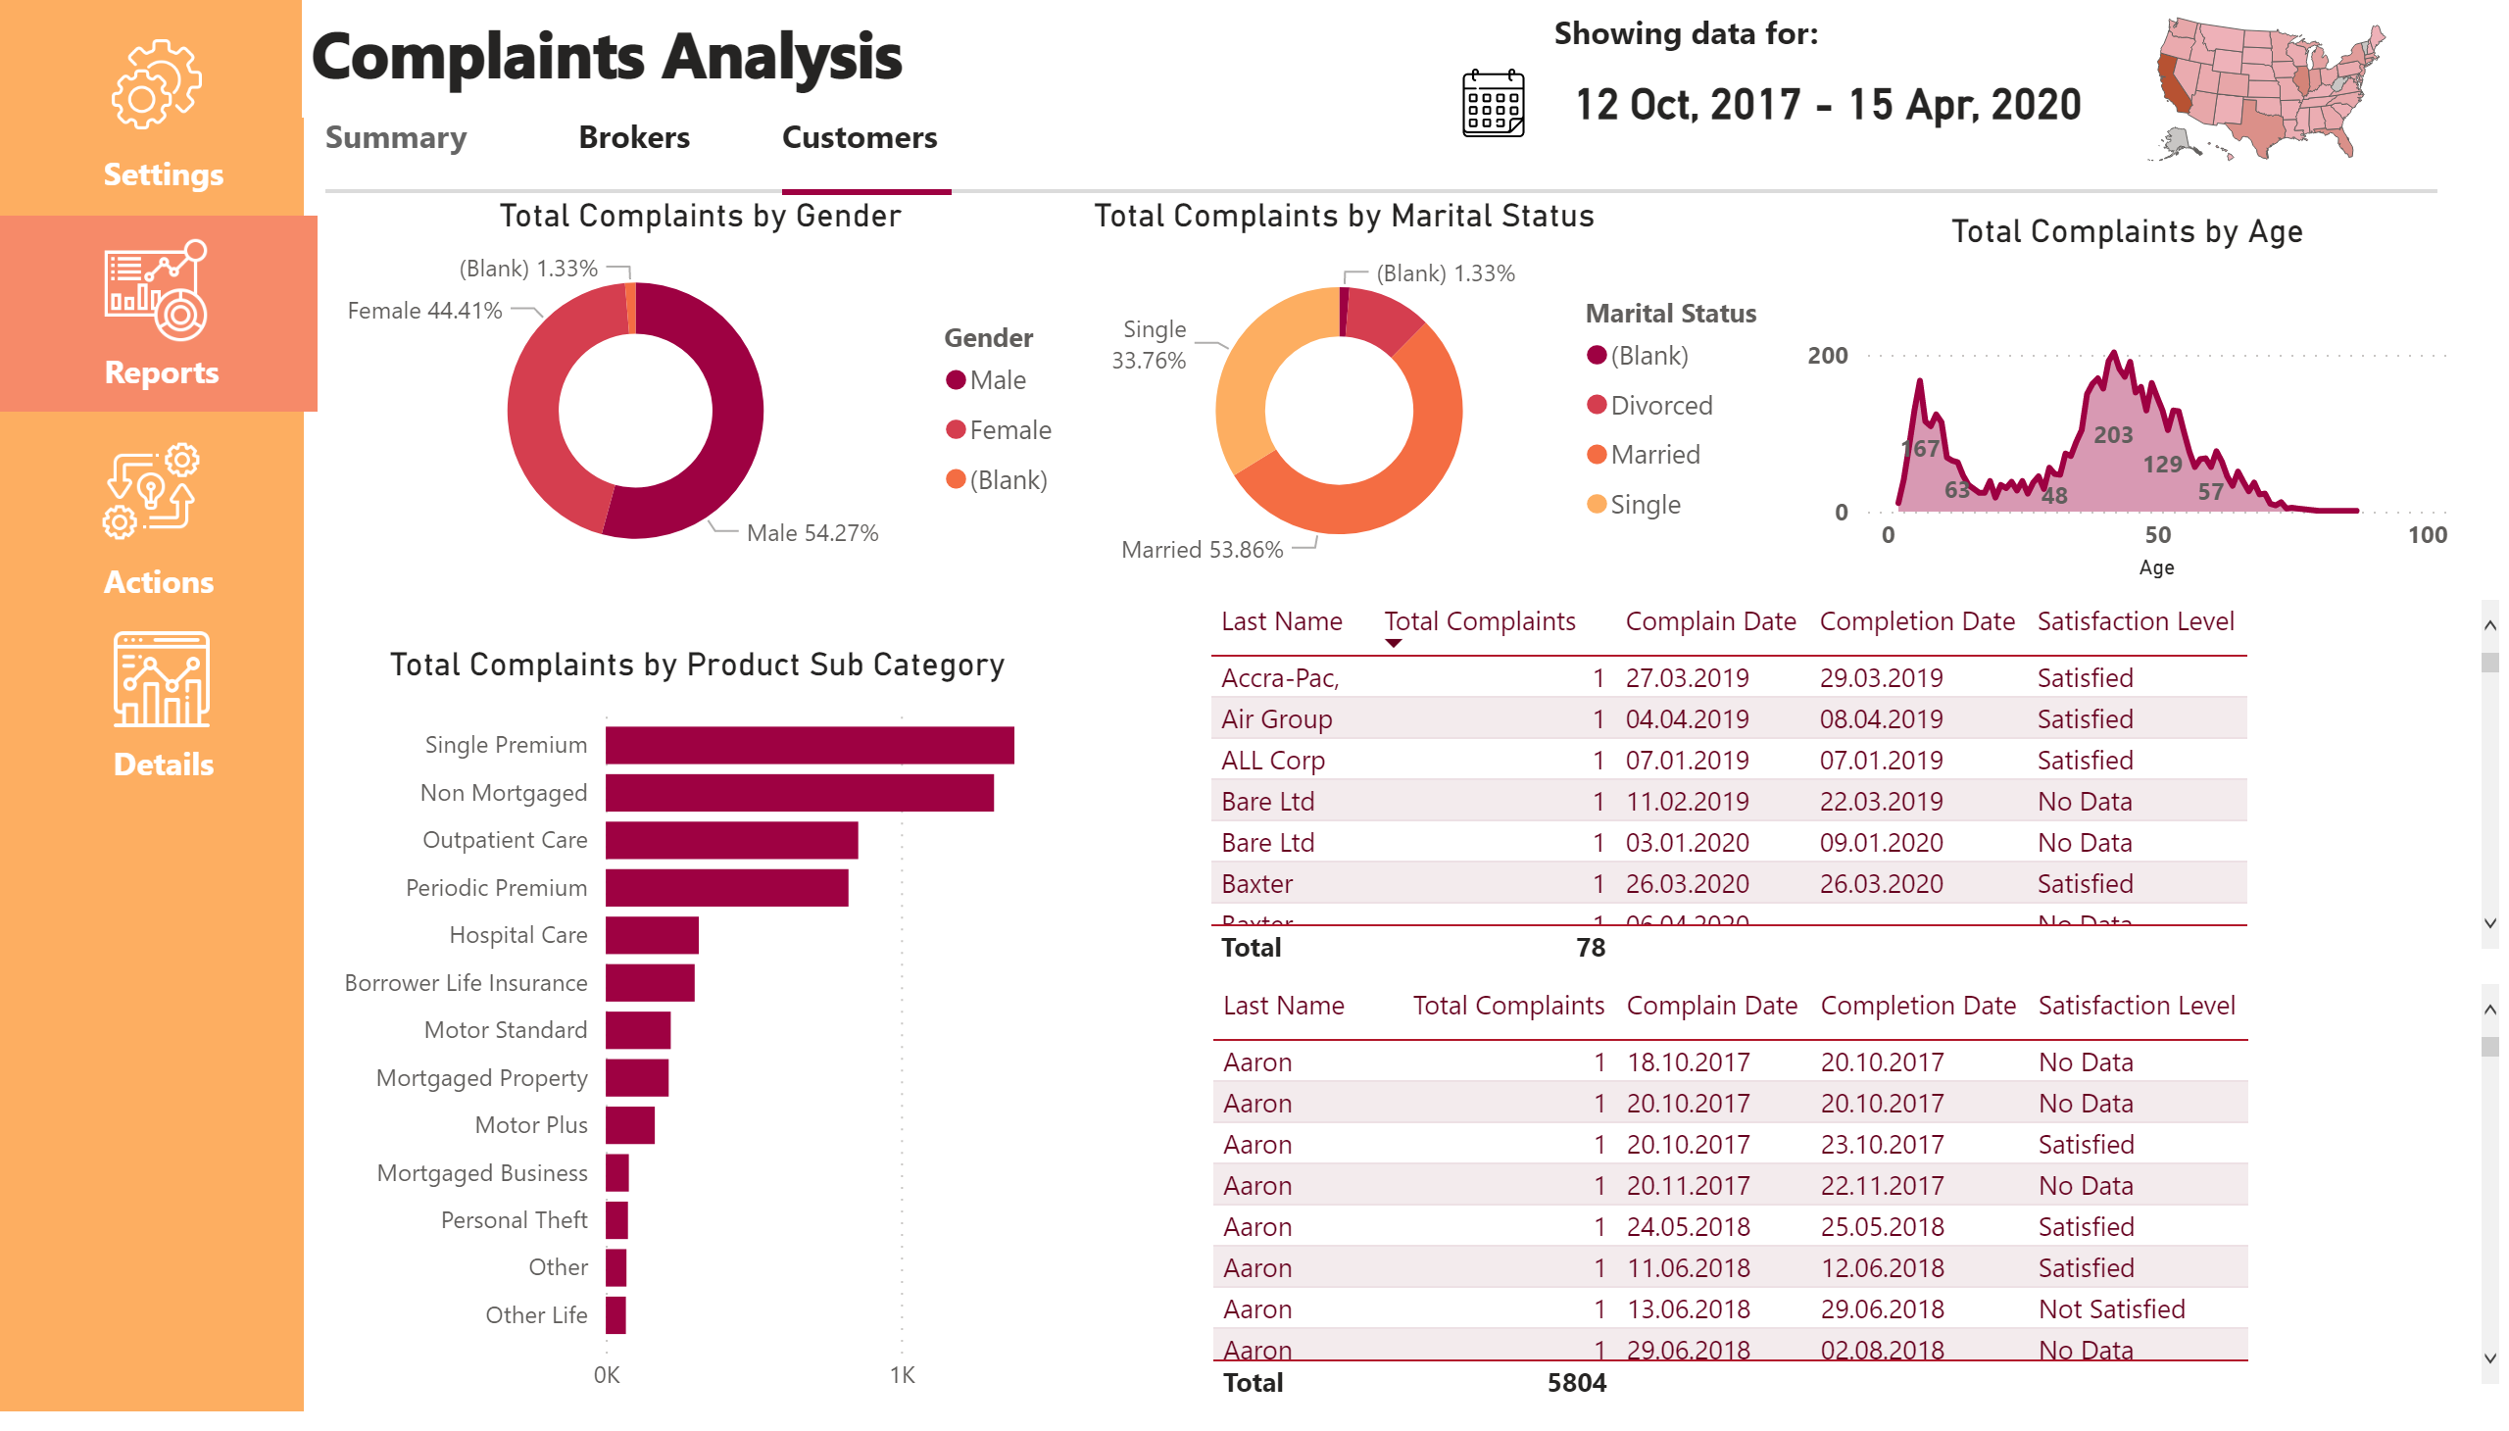
Customers
Notes:
basicShape
No alt text provided
image
No alt text provided
image
No alt text provided
image
No alt text provided
image
No alt text provided
textbox
No alt text provided
textbox
No alt text provided
Reports
No alt text provided
Actions
No alt text provided
Details
No alt text provided
shape
No alt text provided
textbox
No alt text provided
shapeMap
No alt text provided
card
No alt text provided
image
No alt text provided
basicShape
No alt text provided
textbox
No alt text provided
textbox
No alt text provided
textbox
No alt text provided
textbox
No alt text provided
shape
No alt text provided
shape
No alt text provided
shape
No alt text provided
slicer
No alt text provided
basicShape
No alt text provided
donutChart
No alt text provided
barChart
No alt text provided
tableEx
No alt text provided
tableEx
No alt text provided
donutChart
No alt text provided
stackedAreaChart
No alt text provided

Slide 6
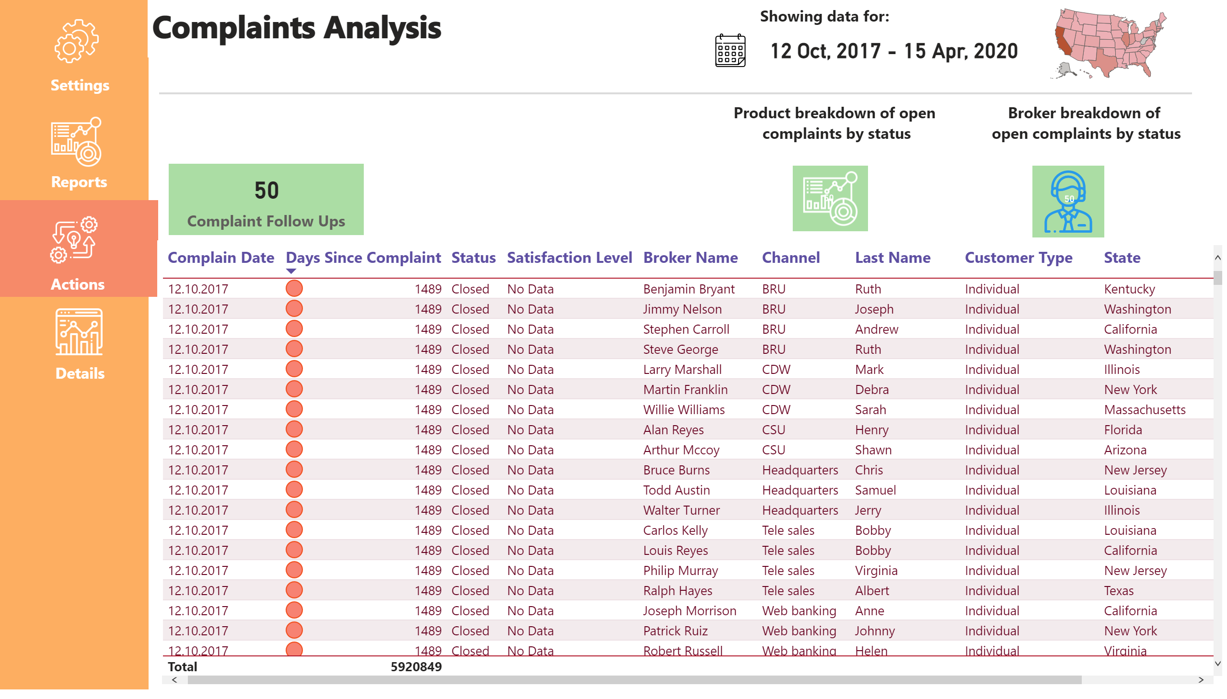
Actions
Notes:
basicShape
No alt text provided
image
No alt text provided
image
No alt text provided
image
No alt text provided
image
No alt text provided
textbox
No alt text provided
textbox
No alt text provided
Reports
No alt text provided
Actions
No alt text provided
Details
No alt text provided
shape
No alt text provided
textbox
No alt text provided
shapeMap
No alt text provided
card
No alt text provided
image
No alt text provided
basicShape
No alt text provided
textbox
No alt text provided
slicer
No alt text provided
tableEx
No alt text provided
image
No alt text provided
card
No alt text provided
card
No alt text provided
textbox
No alt text provided
textbox
No alt text provided
card
No alt text provided
image
No alt text provided

Slide 7
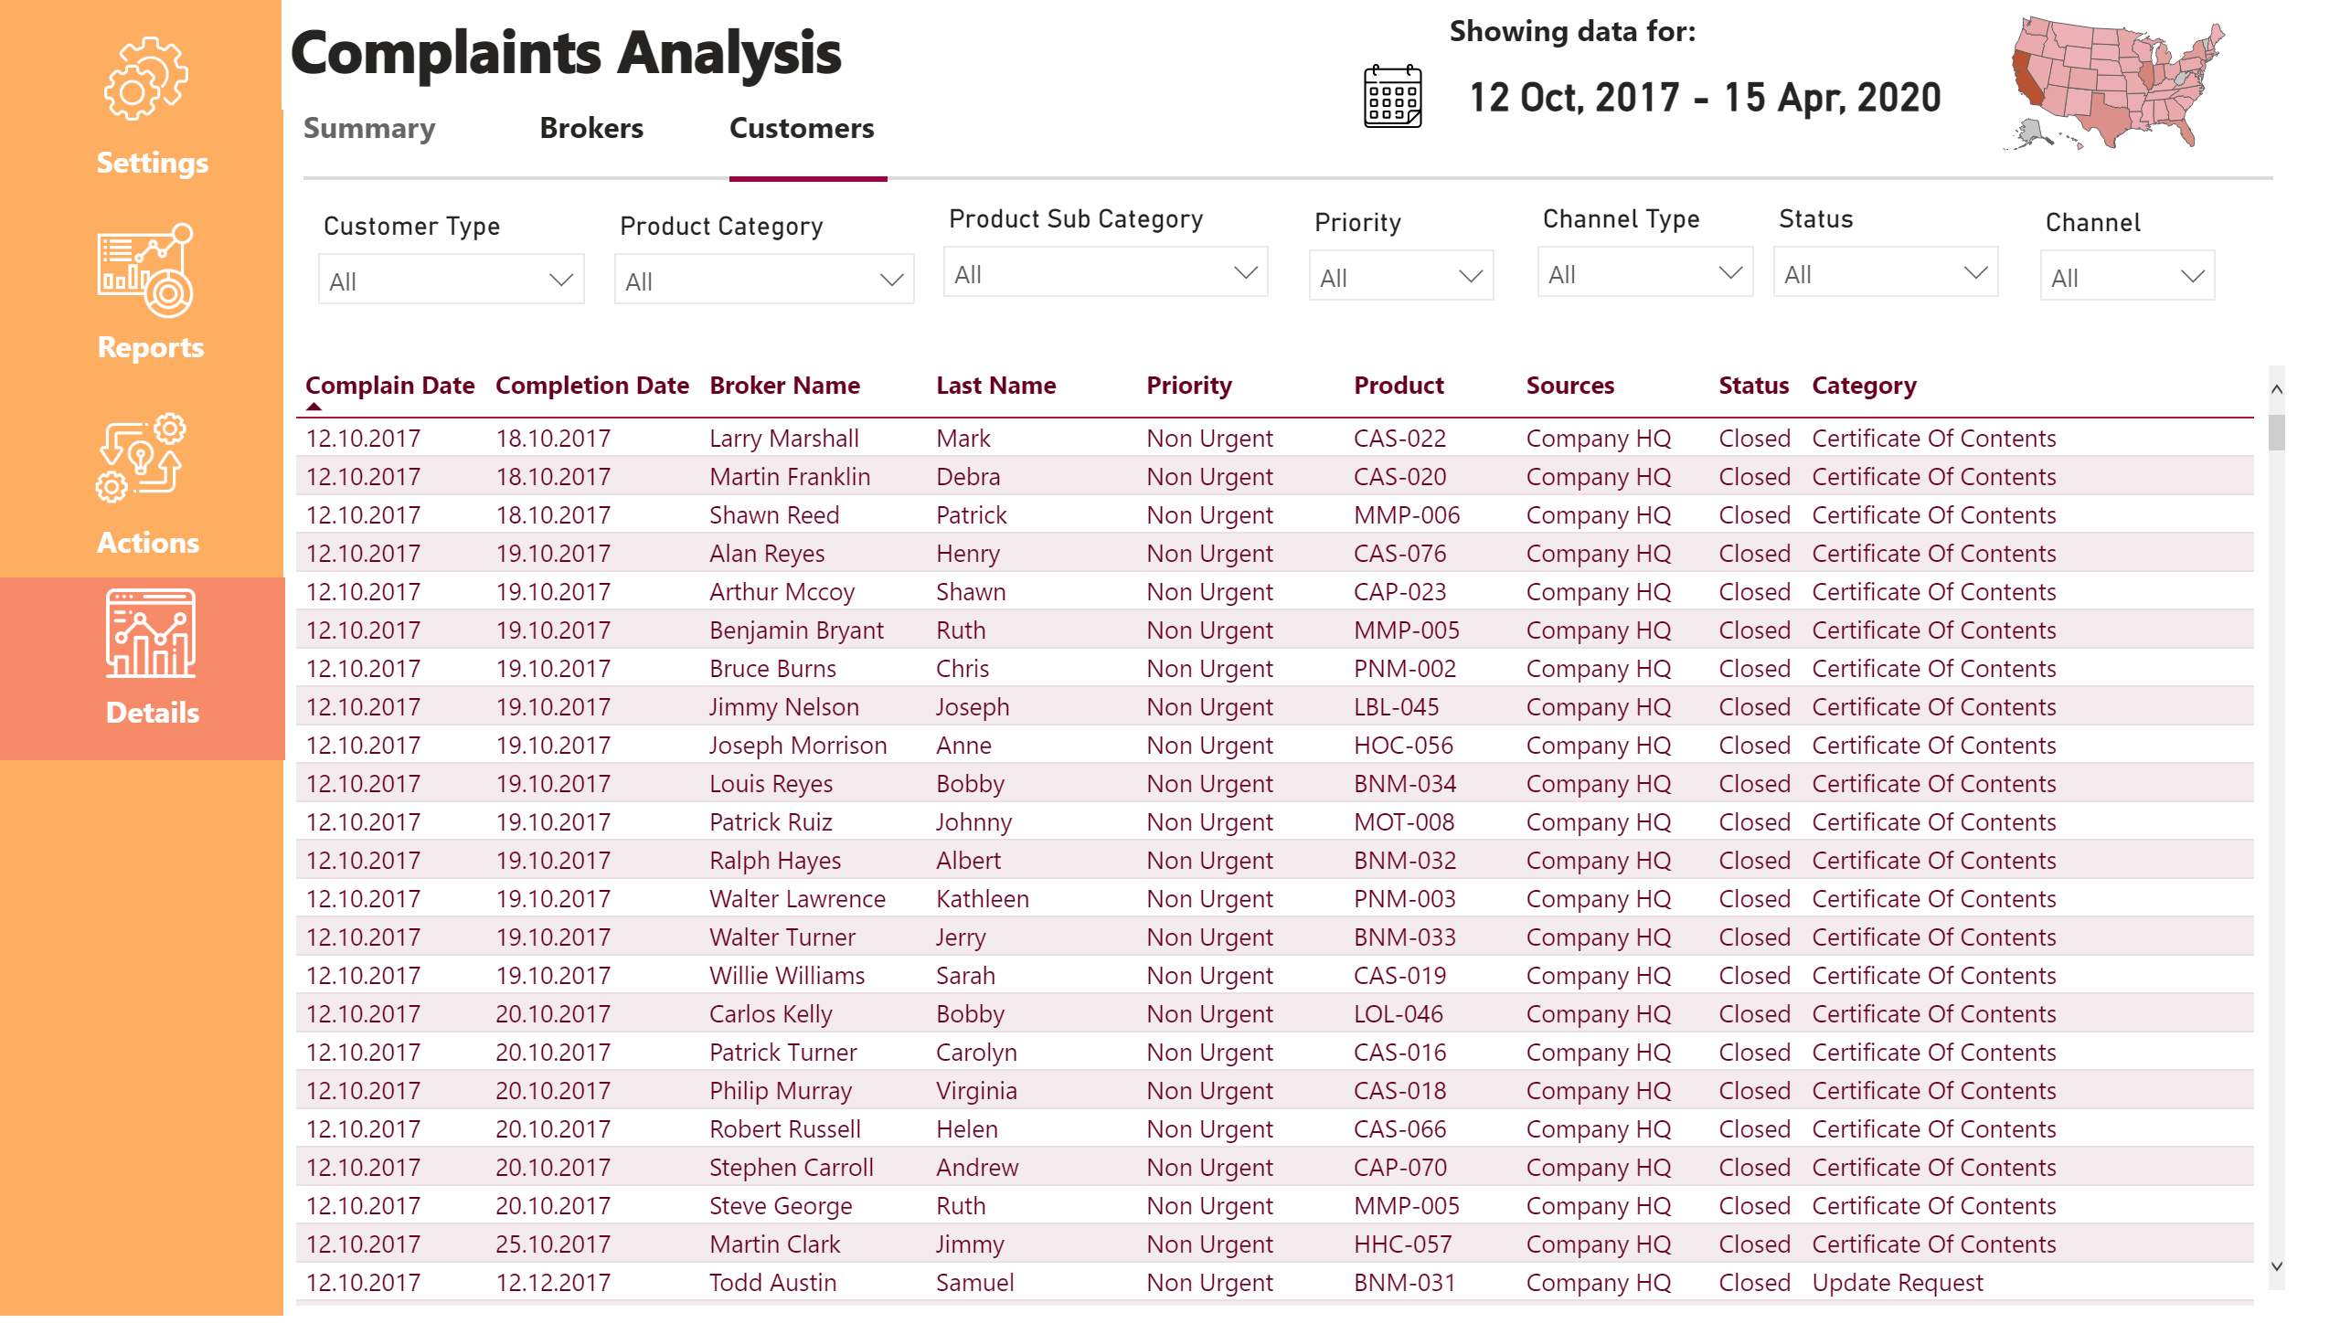
Details
Notes:
basicShape
No alt text provided
image
No alt text provided
image
No alt text provided
image
No alt text provided
image
No alt text provided
textbox
No alt text provided
textbox
No alt text provided
Reports
No alt text provided
Actions
No alt text provided
Details
No alt text provided
shape
No alt text provided
textbox
No alt text provided
image
No alt text provided
basicShape
No alt text provided
textbox
No alt text provided
textbox
No alt text provided
textbox
No alt text provided
textbox
No alt text provided
shape
No alt text provided
shape
No alt text provided
shape
No alt text provided
slicer
No alt text provided
basicShape
No alt text provided
slicer
No alt text provided
slicer
No alt text provided
slicer
No alt text provided
slicer
No alt text provided
slicer
No alt text provided
slicer
No alt text provided
slicer
No alt text provided
card
No alt text provided
shapeMap
No alt text provided
tableEx
No alt text provided

Slide 8
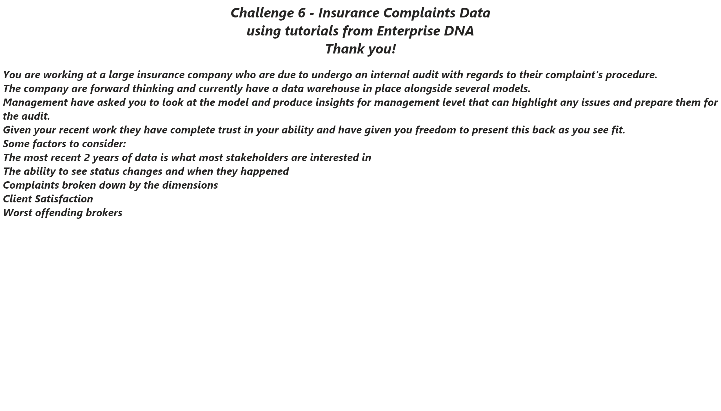
Info
Notes:
textbox
No alt text provided

